Slide 1
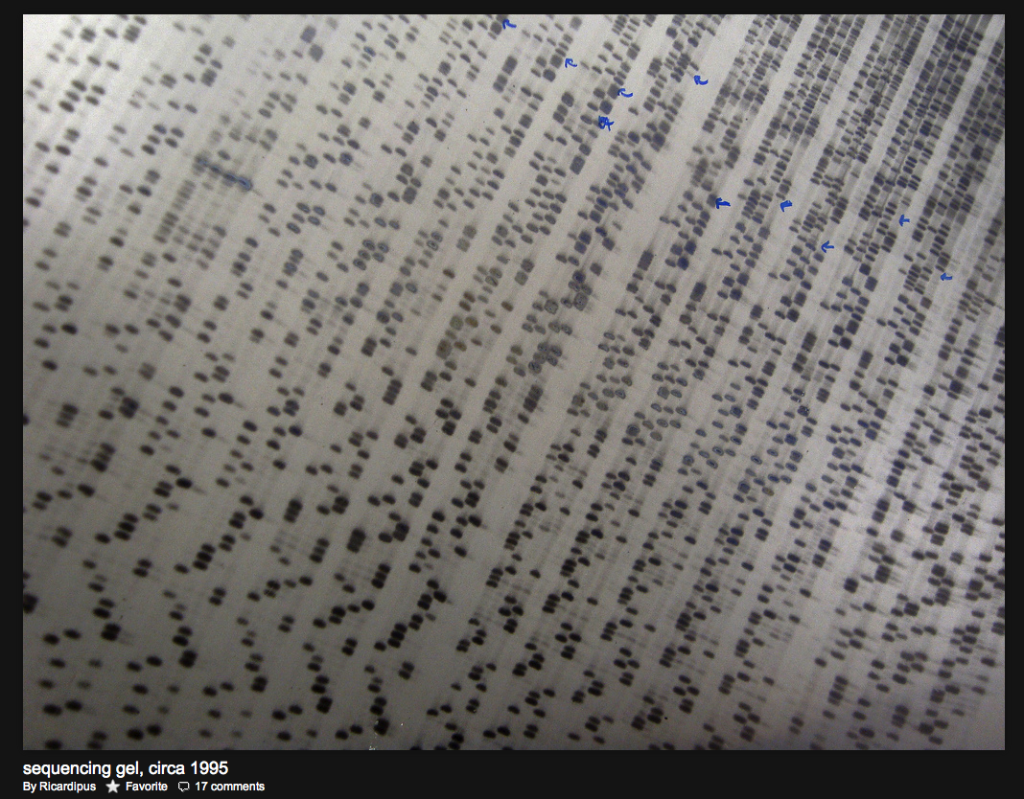
29 Jan 2014 Nucleic acid technology I
Notes:
Yo, sup, intro slide

Slide 2
Learning objectives
• understand how to convert between number of molecules,
volume, and concentration (molarity)
• understand how (yeast) cells are fractionated to isolate specific biological molecules → DNA
• understand how molecular biologists use a variety of enzymes to “cut & paste” DNA
• understand how DNA and proteins can be separated and identified
Notes:
These are the learning objectives.

Slide 3
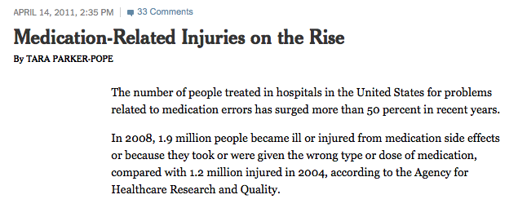

Concentration
Notes:
W0t [][][][][]

Slide 4
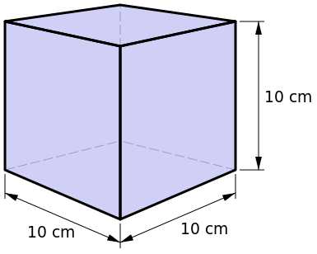
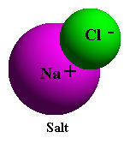
Concentration (molarity) matters! Why?
Because concentration determines how often molecules collide in solution
and determines the rates of reactions and the conditions at equilibrium
molarity → 1 molar = 1 mole of molecules (solute) per liter L (solvent)
1 mole = 6.022 x 10²³ molecules
1 mole = molecular weight of molecule (in grams)
(e.g. 1 mole of NaCl = 58 grams of NaCl)
1 liter
Notes:
0 god rly. Y?

Slide 5
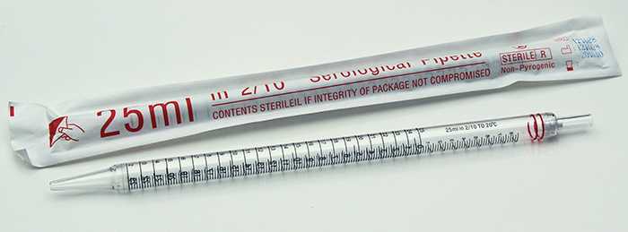
Chemistry lab → mL volumes
Prefix | Symbol | 10^{n} | English
Centi | (c) cm, cL, cM | 10⁻² | Hundredth
Milli | (m) mm, mL, mM | 10⁻³ | Thousandth
Micro | (μ) μm, μL, μM | 10⁻⁶ | Millionth
Nano | (n) nm, nL, nM | 10⁻⁹ | Billionth
1 L = (10 cm)³ = 10³ cm³ = 1000 cm³
1 liter
1 L = 10⁰ L = 10³*(10⁻³ L) = 10³ mL=1000 mL
1 cm
1 mL = 1 cm³
Notes:
Is dis real? Life.

Slide 6
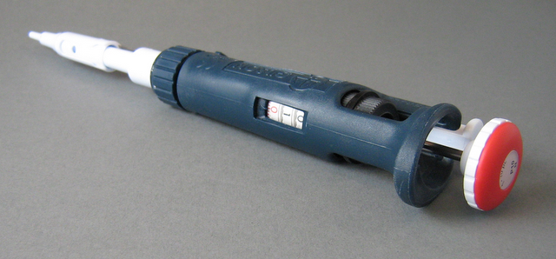
Molecular biology lab → uL volumes
Prefix | Symbol | 10^{n} | English
Centi | (c) cm, cL, cM | 10⁻² | Hundredth
Milli | (m) mm, mL, mM | 10⁻³ | Thousandth
Micro | (μ) μm, μL, μM | 10⁻⁶ | Millionth
Nano | (n) nm, nL, nM | 10⁻⁹ | Billionth
1 mL =1000 uL
1 liter
1 μL = 1 mm³
Q: How many molecules of NaCl in 1 uL of saline?
(Saline is 0.15 molar NaCl)
Notes:
Looks like the same thing.. Just on a different slide

Slide 7
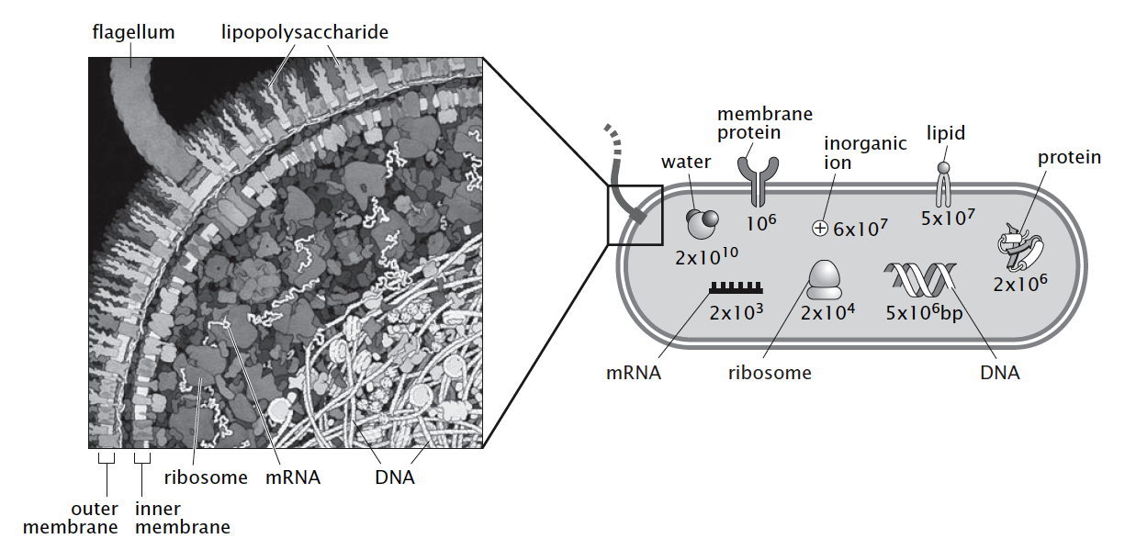
Cell biology in bacteria
1 x 10⁻⁶ m (μm)
E. coli volume ~ 1 x 10⁻¹⁵ L
1 molecule/E. coli ~ 1 x 10⁻⁹ moles/liter (nM)
Q: How many molecules of NaCl in 10⁻¹⁵ L of saline?
(Saline is 0.15 molar NaCl)
Notes:
Wot m8

Slide 8
Nucleic acid purification
Notes:
NAP

Slide 9
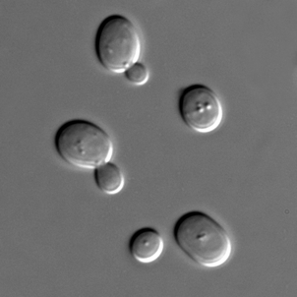
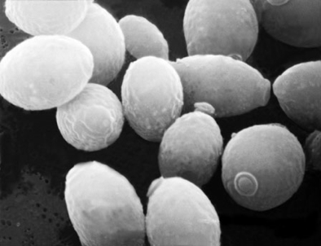
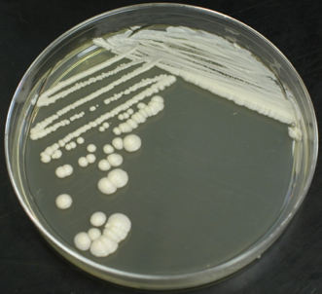
Yeast as a model system
• easy to culture and transform: experimentally tractable
• short generation time: < 2 hours
• haploid or diploid: very useful for genetic analysis
• compact genome: few introns, close intergenic spacing
Saccharomyces cerevisiae: budding yeast, baker’s yeast, brewing yeast
Notes:
Reproduce asexually every 90 minutes
Can be BOTH haploid or diploid

Slide 10
Nucleic acid purification
We need to isolate DNA from the other molecules (RNA, protein, lipids, sugars)
Chemical properties (e.g. pH, charge, polar, hydrophobic, solubility)
Enzymes (e.g. nucleases, proteinases)
Cellular location (e.g. nucleus)
Physical properties (e.g. circular, size, temp.)
Notes:
NAP AGAIN

Slide 11
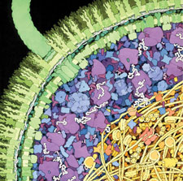
Bio201 lab: Yeast DNA isolation
Yeast genomic DNA
cell walls (sugars)
membrane (lipids)
proteins
RNA
DNA
Notes:
Detergent

Slide 12
Bio201 lab: Yeast DNA isolation
Yeast genomic DNA
cell walls are removed enzymatically (e.g. lyticase) or ruptured by force (e.g. beads)
membrane
proteins
RNA
DNA

Slide 13
Bio201 lab: Yeast DNA isolation
Yeast genomic DNA
cell walls are removed enzymatically (e.g. lyticase) or ruptured by force (e.g. beads)
cell contents are released by detergent treatment of membrane (e.g. SDS)
proteins
RNA
DNA
Notes:
JEOIJGOIWJEG

Slide 14
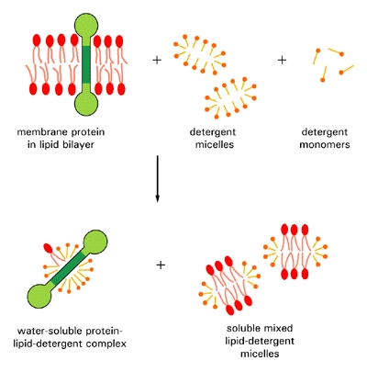
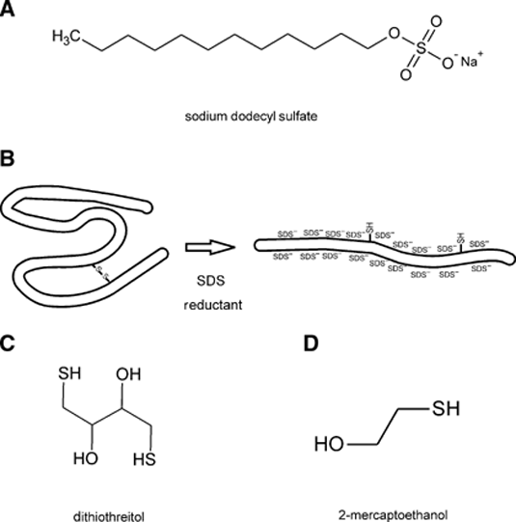
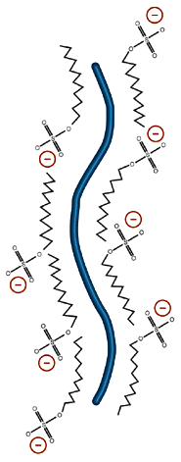
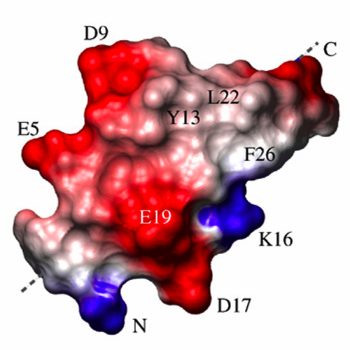
SDS detergent, lipids, and proteins
Lipids and detergents (e.g. SDS) both have polar head
group and long fatty chain (“oil”)
SDS disrupts lipid bilayer
SDS denatures proteins
Notes:
SDS IS GOD

Slide 15
Bio201 lab: Yeast DNA isolation
Yeast genomic DNA
cell walls are removed enzymatically (e.g. lyticase) or ruptured by force (e.g. beads)
cell contents are released by detergent treatment of membrane (e.g. SDS)
proteins are denatured by SDS & precipitated out w/ high salt
RNA
DNA
Notes:
But at high concentrations of salt, the solubility of the proteins drops sharply. This is termed Salting out.

Slide 16
Protein precipitation
If you compete two solutes (e.g. lots of salt versus protein) for the same solvent (e.g. water), there will be insufficient water molecules to interact with protein, and the protein will begin to precipitate out → “salting out”
-
Notes:
No but rly

Slide 17
Bio201 lab: Yeast DNA isolation
Yeast genomic DNA
cell walls are removed enzymatically (e.g. lyticase) or ruptured by force (e.g. beads)
cell contents are released by detergent treatment of membrane (e.g. SDS)
proteins are denatured by SDS & precipitated out w/ high salt
RNA/DNA precipitates in high salt and and and ethanol
RNA
DNA

Slide 18
DNA precipitation
Salt + DNA + poor solvent (e.g. ethanol) leads to formation of salt+ DNA- precipitate.
high salt + ethanol
high salt
+ + + + + + + + + +
_ _ _ _ _ _ _ _ _ _ _
poor
solvent
+ + + + + + + + + +
+ + + + + + + + + +
_ _ _ _ _ _ _ _ _ _ _
_ _ _ _ _ _ _ _ _ _ _
+ + + + + + + + + +
+ + + + + + + + + +
+ + + + + + + + + +
_ _ _ _ _ _ _ _ _ _ _
_ _ _ _ _ _ _ _ _ _ _
+ + + + + + + + + +
+ + + + + + + + + +
_ _ _ _ _ _ _ _ _ _ _
+ + + + + + + + + +
+ + + + + + + + + +
Notes:
Wot. Looks like DNA hamburger

Slide 19
Bio201 lab: Yeast DNA isolation
Yeast genomic DNA
cell walls are removed enzymatically (e.g. lyticase) or ruptured by force (e.g. beads)
cell contents are released by detergent treatment of membrane (e.g. SDS)
proteins are denatured by SDS & precipitated out w/ high salt
RNA/DNA precipitates in high salt and and and ethanol
RNase degrades RNA
DNA

Slide 20
Q: How do we change our protocol if we want to isolate human RNA?
cell walls are removed enzymatically (e.g. lyticase) or ruptured by force (e.g. beads)
cell contents are released by detergent treatment of membrane (e.g. SDS)
proteins are denatured by SDS & precipitated out w/ high salt
RNA/DNA precipitates in high salt
and ethanol
RNase degrades RNA
DNA
Notes:
Real procedure

Slide 21
Enzymatic manipulations
Notes:
EM

Slide 22
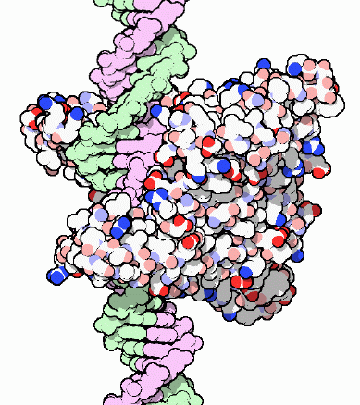
Restriction enzymes
Cut double-stranded DNA
Cut at specific locations
based on nucleotide sequence
Protein Data Base

Slide 23
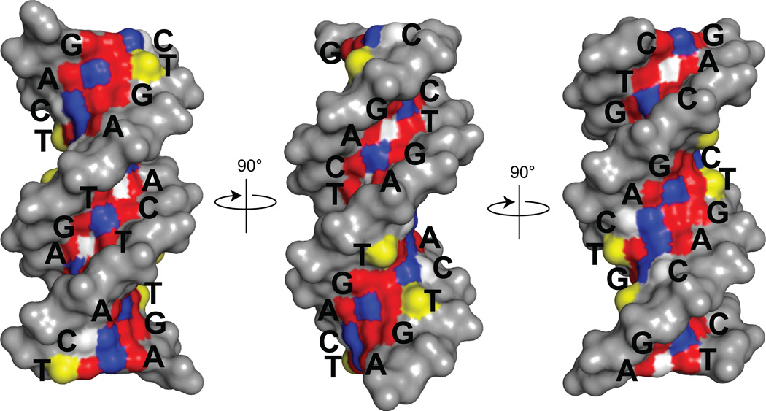
A chemical perspective of DNA sequence
Major
groove
Minor
groove
H-bond acceptor
H-bond donor
Methyl

Slide 24
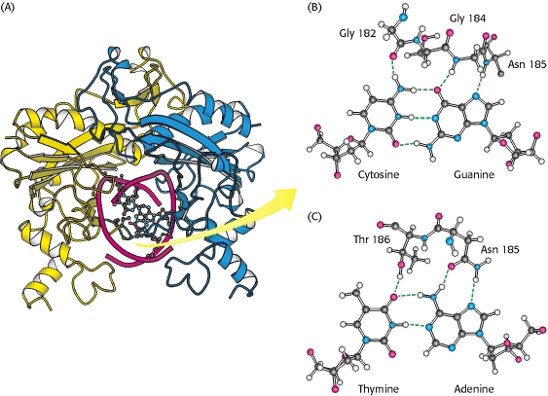
Restriction enzymes recognize specific bases
Berg, Tymoczko, Stryer (2002) Biochemistry

Slide 25
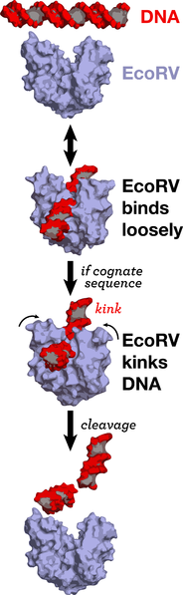
Molecular mechanisms of DNA cleavage
• EcoRV forms a homodimer
• binds weakly and nonspecifically to DNA
• diffuses (“random walk”) along DNA
• binds highly specifically to recognition sequence
• bends DNA about 50˚, opens major groove
• phosphodiester bond moved near active site
• cleavage occurs within recognition sequence

Slide 26
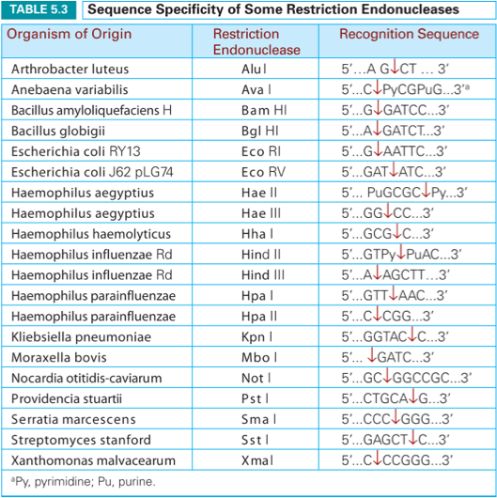
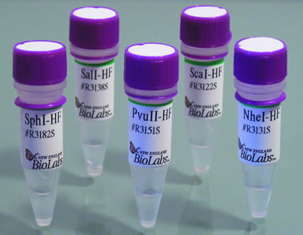
Many recognition sequences are available
New England BioLabs
Tropp, Table 5.3

Slide 27
If my DNA is a random string of letters (AGCTs), how often should I expect to cut with …
(NOTE: Each nucleotide is as likely as the other → ¼ chance)
MboI enzyme that recognizes GATC?
AluI enzyme that recognizes AGCT?
EcoRV enzyme that recognizes GATATC?
NotI enzyme that recognizes GCGGCCGC?

Slide 28
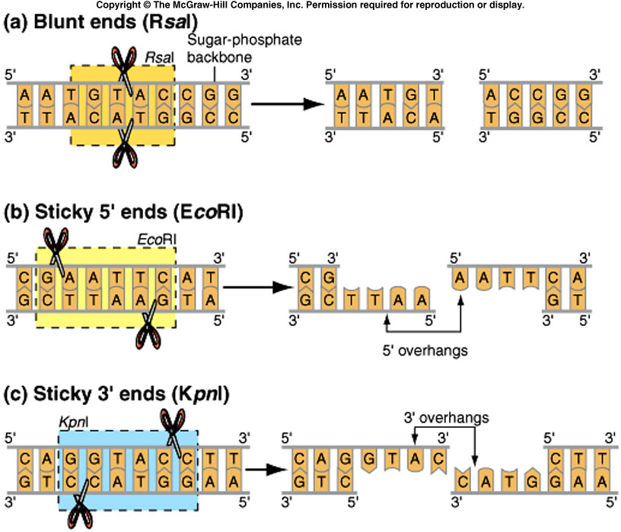
Blunt and sticky ends
Blunt ends: RsaI
5’ sticky ends: EcoRI
McGraw-Hill Companies
3’ sticky ends: KpnI

Slide 29
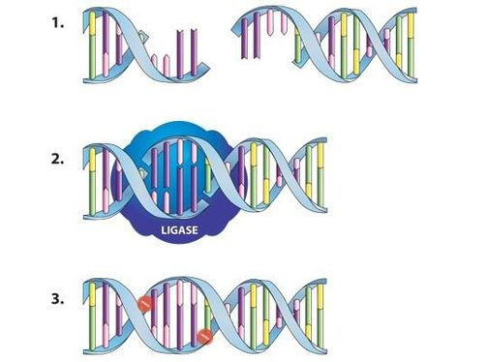
Ligation
DNA with sticky ends
New Zealand Biotechnology Learning Hub
DNA ligase aligns the ends...
...makes new covalent bonds

Slide 30
Gel electrophoresis

Slide 31
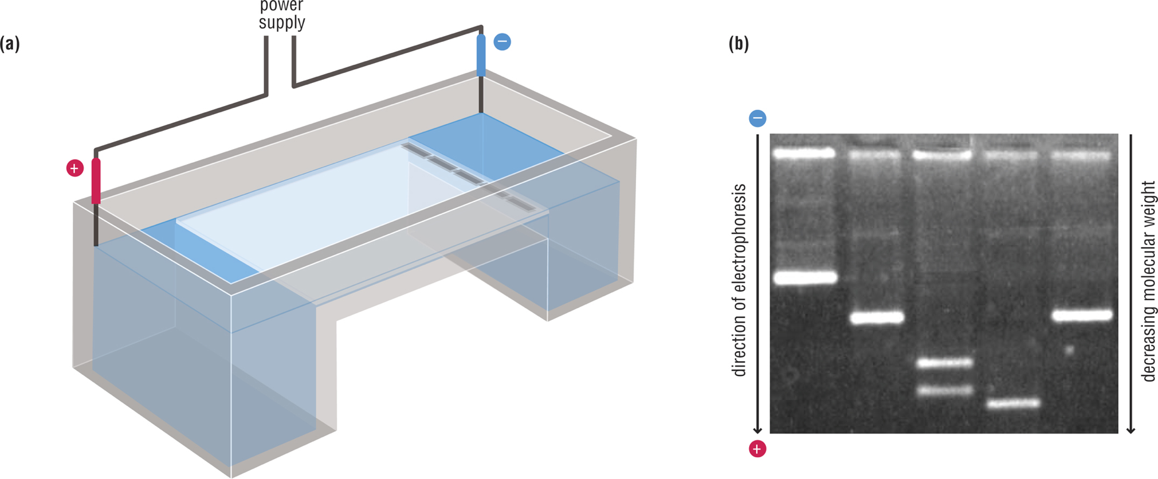
DNA gel electrophoresis
samples placed
in wells in gel
gel of
agarose
Craig et al, Figure 16.35
gel rig
separation of DNA by size

Slide 32
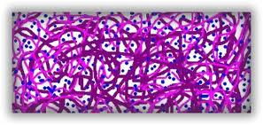
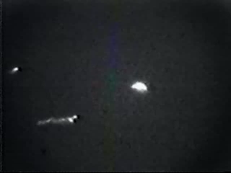
Gel is a “sieve” that helps separate
long DNA from short DNA
Electric field
DNA hooks onto gel
Snake-like migration of
chain ends through gel
(“reptation”)
Tug-of-war between
stretched ends
“Losing” end catches up
as DNA “collapses”
Carlos Bustamante, Berkeley

Slide 33
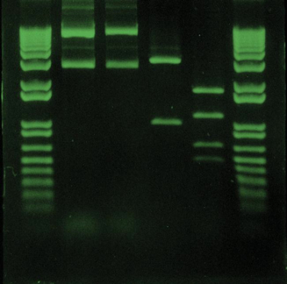
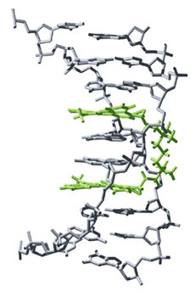
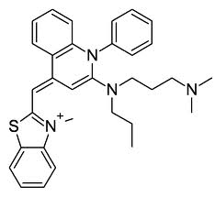
Visualizing DNA in the gel
Molecular Probes
SYBR® Green dye
dye intercalated into DNA

Slide 34
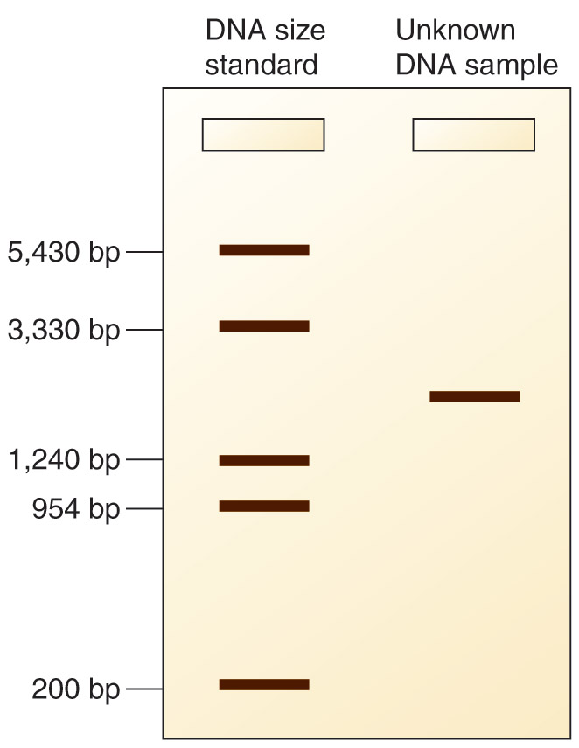
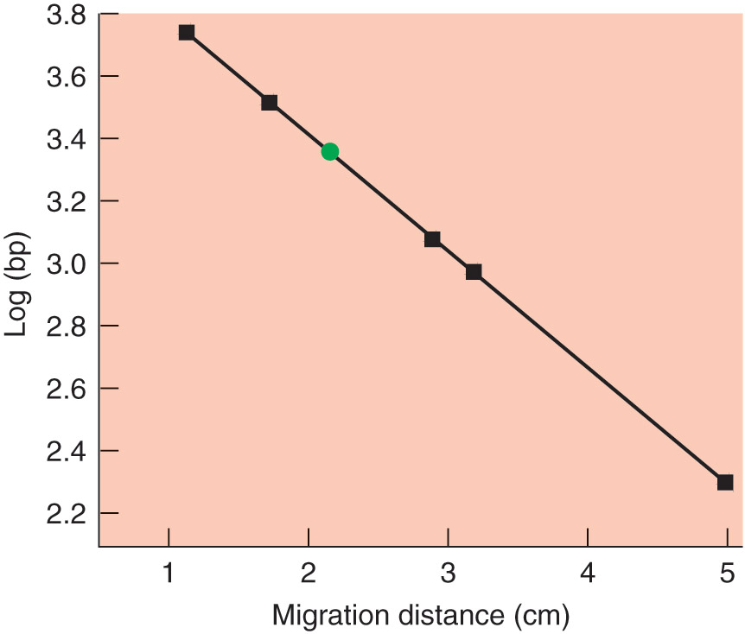
DNA size determination by electrophoresis
Ladder
Figure 5.13b
Adapted from an illustration by Michael Blaber, Florida State University

Slide 35
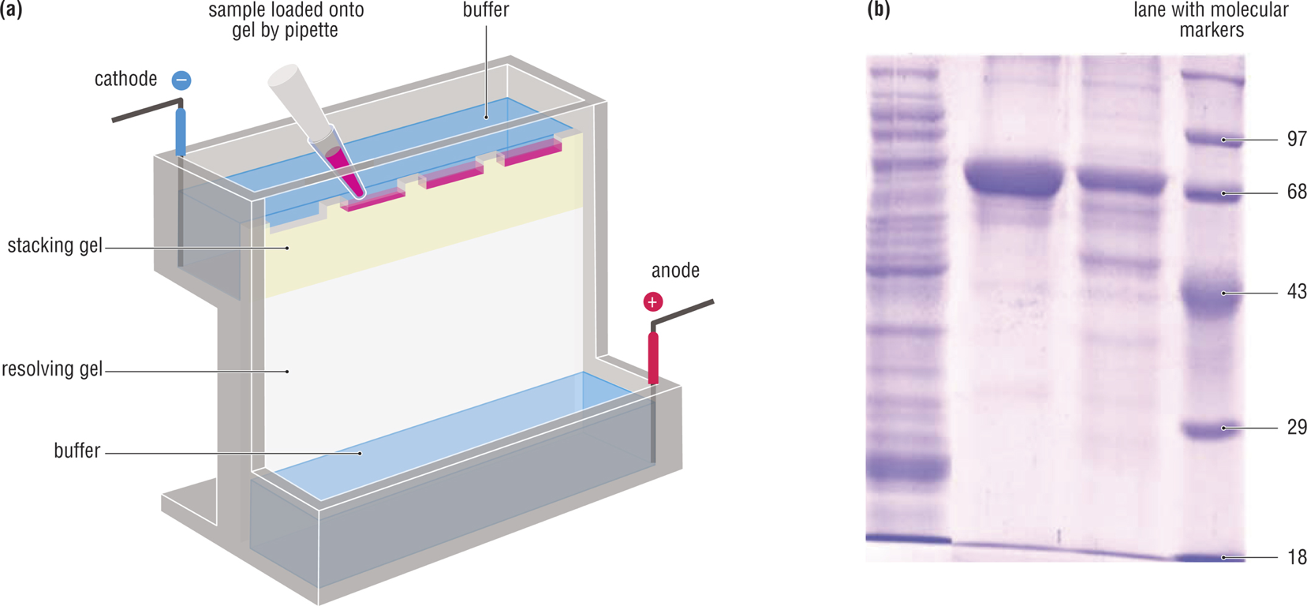
Protein gel electrophoresis
gel rig
separation of protein by size
Craig et al., Figure 16.36

Slide 36
Challenges with proteins
Proteins are not uniformly charged
Proteins are folded
Proteins can have disulfide bonds

Slide 37
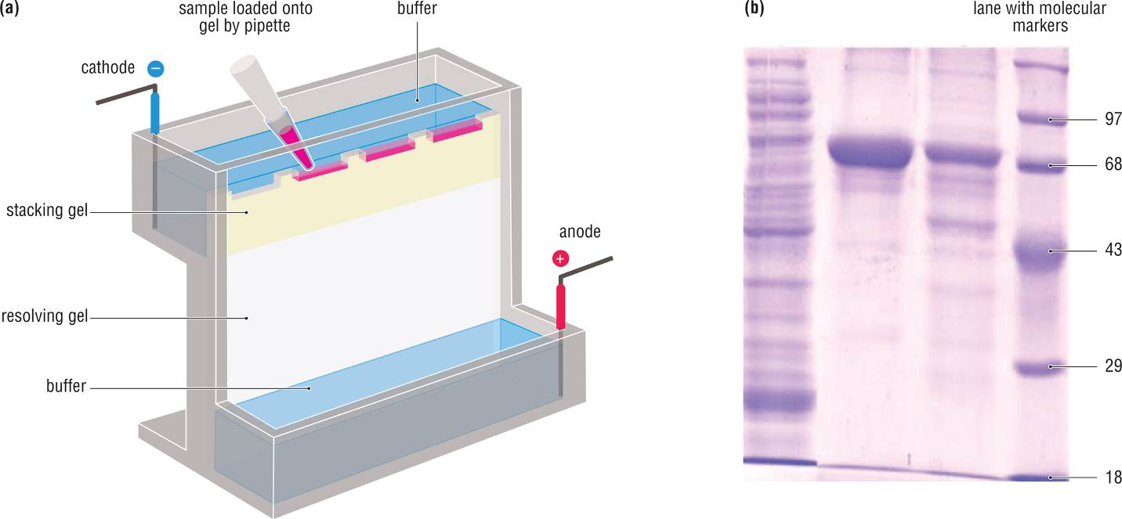
SDS-PAGE (to separate on size alone)
SDS & mercaptoethanol denature and coat protein with charge
-

